Slide 1
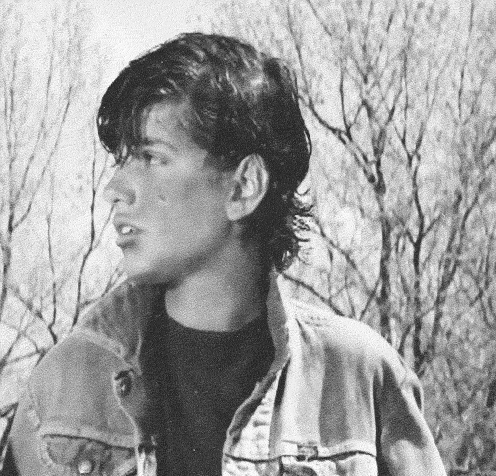
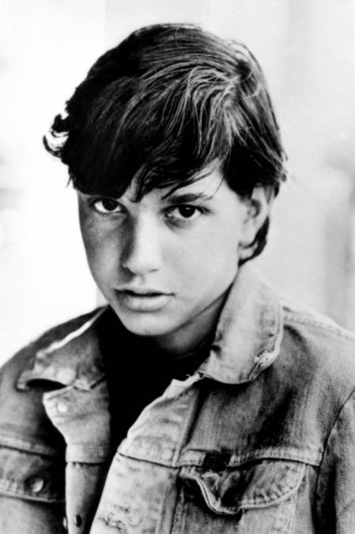
WANTED by the FBI
Wanted for the murder of Bob Sheldon
Johnny “Johnnycake” Cade
Armed and Dangerous
Has a scar on the left side of his cheek
Description
Date of Birth: 3-1-53
Age: 16
Height: 5’7 Weight: 125 lbs. Hair Color: Black Eye Color: Dark Brown
Remarks:
The Federal Bureau of Investigation is seeking the whereabouts of this person.
SHOULD BE CONSIDERED ARMED AND EXTREMELY DANGEROUS.
If you have any information concerning this person, please call 1-800-CALL-FBI or dial 911.

