Slide 1
Tissue Lab Image Practice
Histology Practice

Slide 2
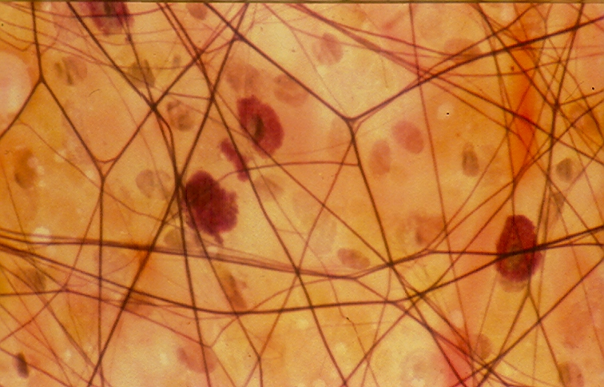
SLIDE “A”
TISSUE TYPE?
Can you identify these structures? fibroblasts
Macrophages
Mast Cells
Collagen Fibers
Elastin Fibers
ECM

Slide 3
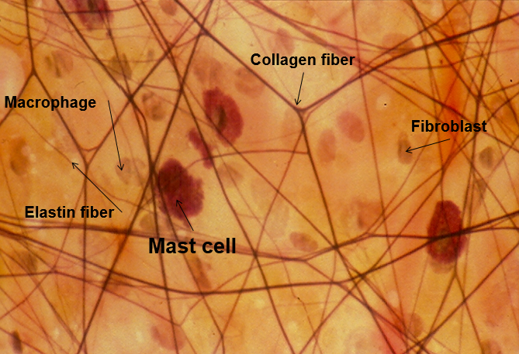
SLIDE “A” Answers
Tissue Type:
CONNECTIVE (Areolar or Loose)
STRUCTURES: fibroblasts
Macrophages
Mast Cells
Collagen Fibers
Elastin Fibers
ECM – space without structures

Slide 4
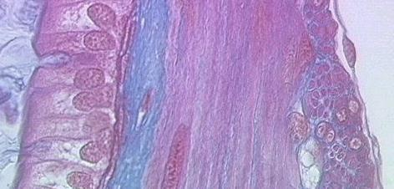
SLIDE “B”
Tissue Type?
(Focus on the left side of the image)
FEATURES/STRUCTURES: One layer
Rectangular-shaped Cells
Cilia
Basement Membrane

Slide 5
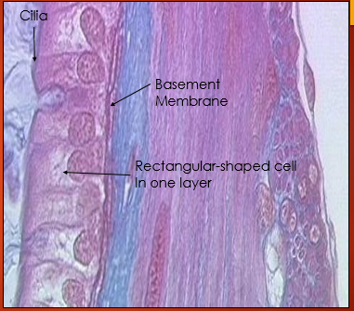
SLIDE “B” Answers
Tissue Type:
(Focus on the left side of the image)
Epithelium (Simple Columnar)
FEATURES/STRUCTURES: One layer
Rectangular-shaped Cells
Cilia
Basement Membrane

Slide 6
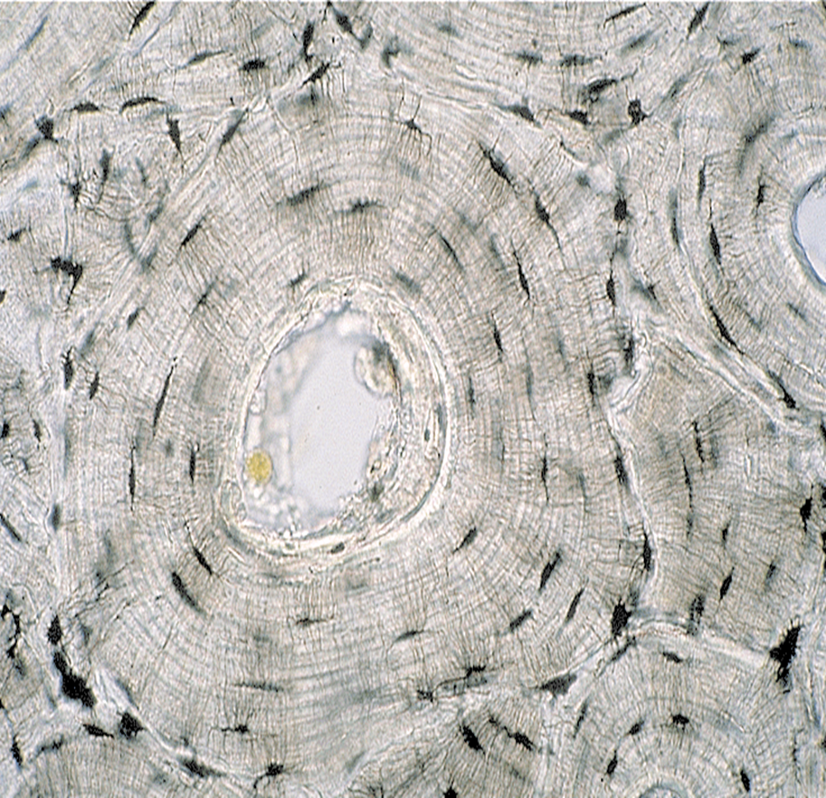
SLIDE “C”
Tissue Type?
FEATURES/STRUCTURES:
Haversian Canal
OSteons

Slide 7
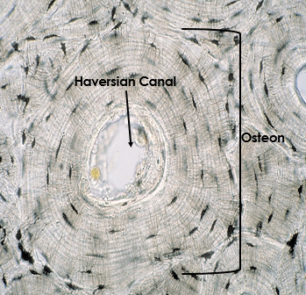
SLIDE “C”
ANSWERS
Tissue Type:
CONNECTIVE (Compact Bone)
FEATURES/STRUCTURES: Haversian Canal - where blood vessels and nerves travel through bone
OSTEON – concentric circular region

Slide 8
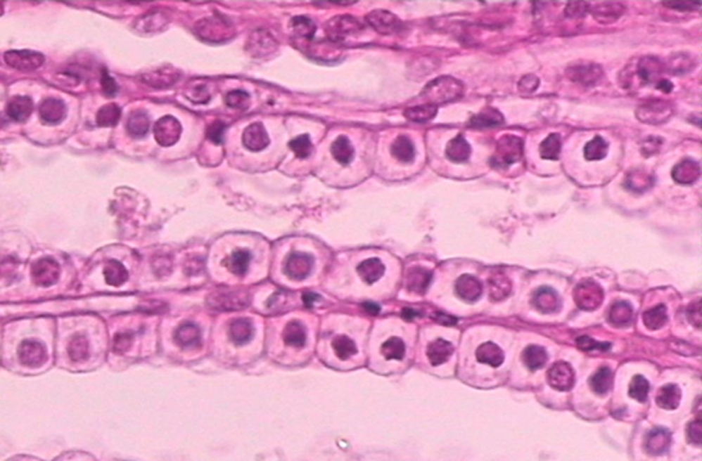
SLIDE “D”
Tissue Type?
FEATURES/STRUCTURES:

Slide 9
SLIDE “D” Answers
Tissue Type:
EPITHELIUM
(Simple CuboidAL)
FEATURES/STRUCTURES:

Slide 10
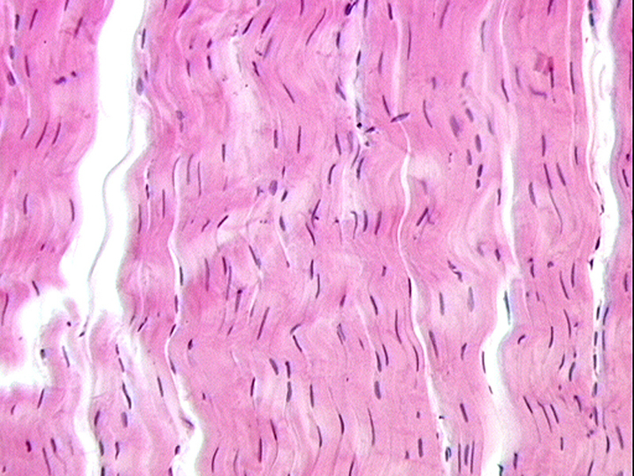
SLIDE “E”
Tissue Type?
FEATURES/STRUCTURES:
Where is it found?
Collagen Fibers
Fibroblasts

Slide 11
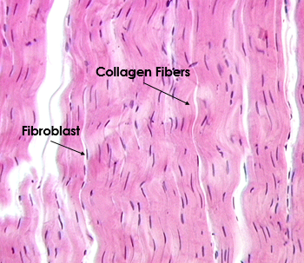
SLIDE “F” Answers
Tissue Type:
CONNECTIVE (Dense regular)
FEATURES/STRUCTURES:
Found in ligament and tendons
Collagen
Fibroblasts

Slide 12
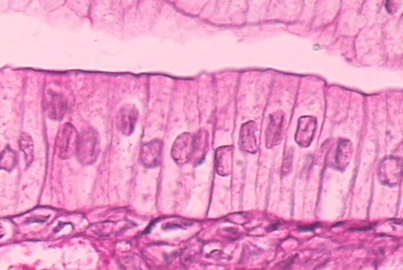
SLIDE “G”
Tissue Type?
FEATURES/STRUCTURES:

Slide 13
SLIDE “G”
ANSWERS
Tissue Type:
EPITHELIUM
(SIMPLE COLUMNAR)
FEATURES/STRUCTURES:

Slide 14
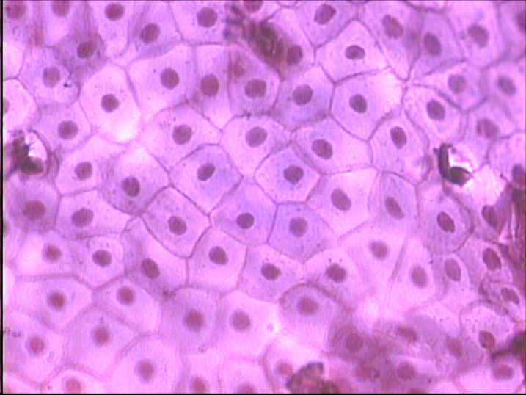
SLIDE “H”
Tissue Type?
FEATURES/STRUCTURES:
Shape?

Slide 15
SLIDE “H”
ANSWERS
Tissue Type:
EPITHELIUM
(Simple Squamous)
FEATURES/STRUCTURES:
Flat, Scale-like
single layer

Slide 16
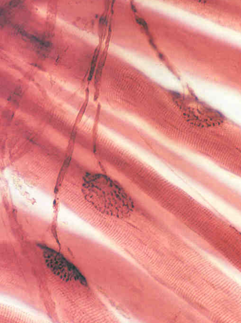
SLIDE “I”
ANSWERS
Tissue Type:

Slide 17
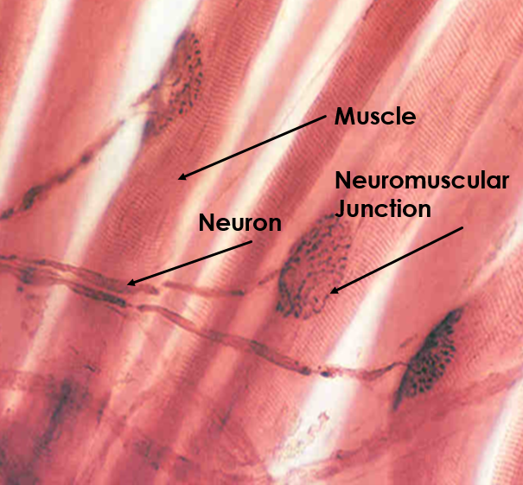
SLIDE “I”
ANSWERS
Tissue Type:
Nervous and Muscular (NEUROMUSCULAR JUNCTON)
Where a nerve and muscle meet

Slide 18
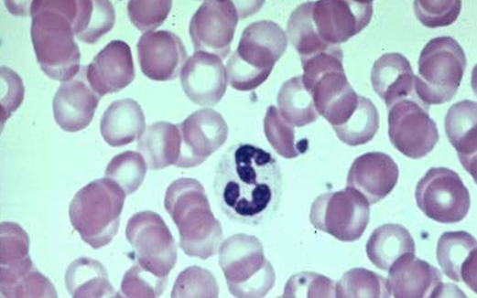
SLIDE _J”
Tissue Type:
FEATURES/STRUCTURES:
What are the purple structures?
What is the large structure in the center?
Where is the plasma (liquid portion) of the blood?

Slide 19
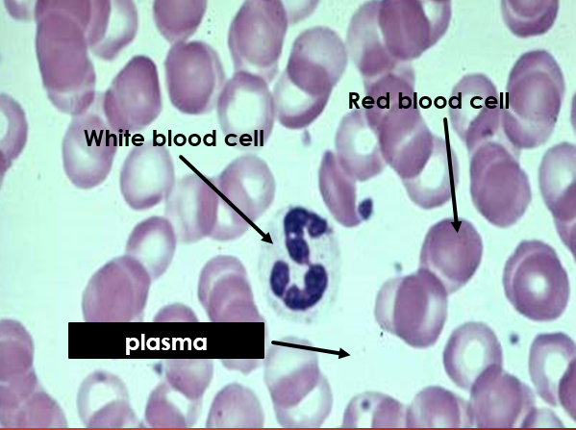
SLIDE _J”
ANSWERS
Tissue Type:
Connective (Blood)
FEATURES/STRUCTURES:
What are the purple structures? Red blood cells
What is the large structure in the center? White blood cell
Where is the plasma (liquid portion) of the blood? Plasma

Slide 20
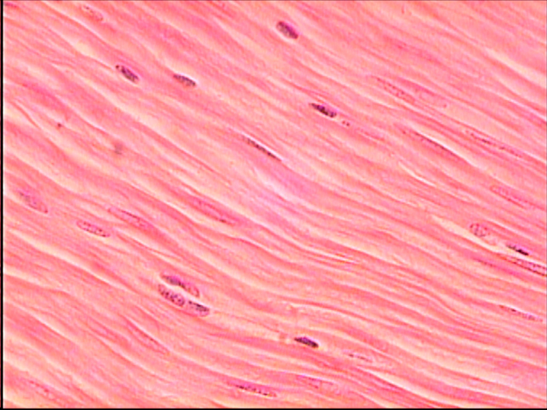
SLIDE “K”
Tissue Type:

Slide 21
SLIDE “K” Answers
Tissue Type:
MUSCLE (SMOOTH)
FEATURES/STRUCTURES:
No striations

Slide 22
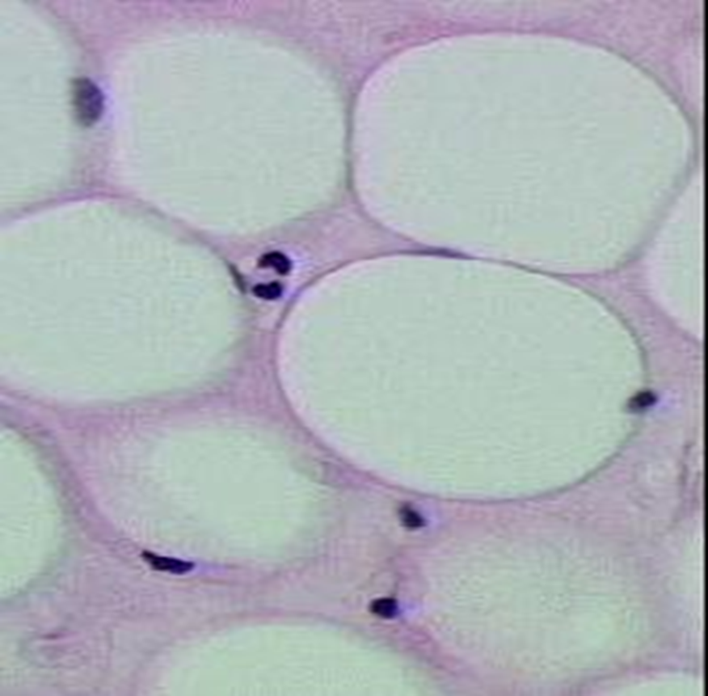
SLIDE “L”
Tissue Type?
FEATURES/STRUCTURES:
What are the white circular structures?

Slide 23
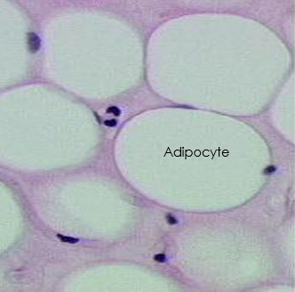
SLIDE “L” Answers
Tissue Type:
CONNECTIVE (Adipose)
FEATURES/STRUCTURES:
The white circular structures are adipocytes (cells functioning in fat storage for energy and insulation).

Slide 24
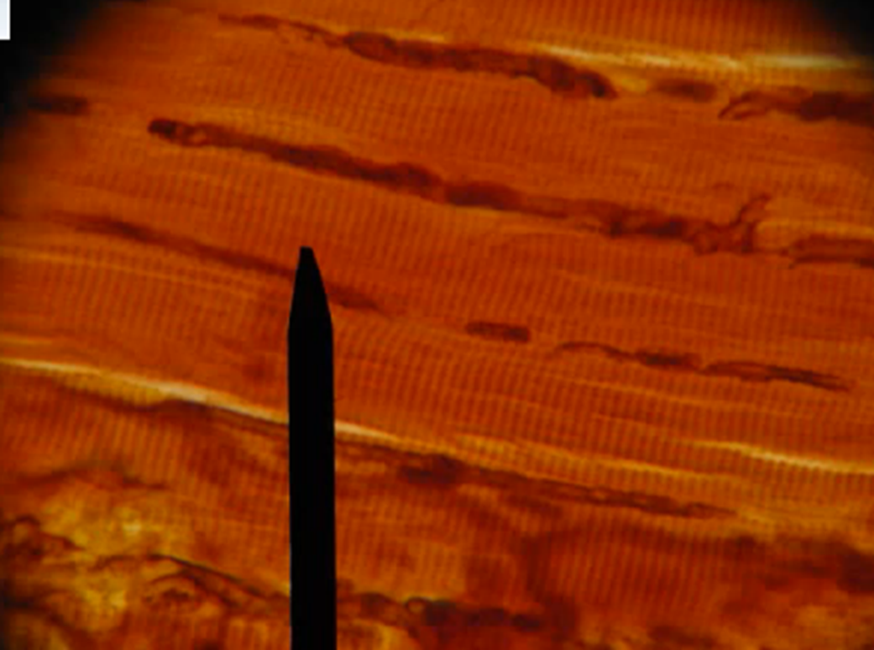
SLIDE “M”
Tissue Type:
FEATURES/STRUCTURES:
Striations
Multi-nucleated

Slide 25
SLIDE “M” Answers
Tissue Type:
Muscle (Skeletal)
FEATURES/STRUCTURES:
Striations
Multi-nucleated

Slide 26
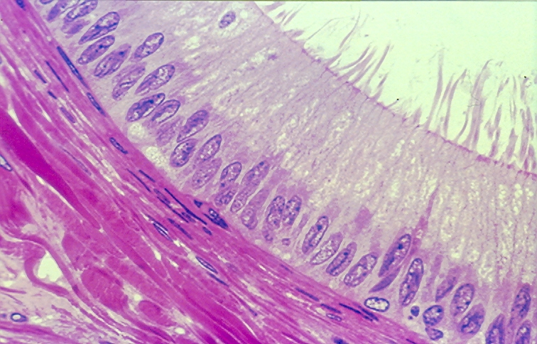
SLIDE “N”
Tissue Type?
FEATURES/STRUCTURES:
Cilia
Appears multi-layered but is Not
Basement Membrane

Slide 27
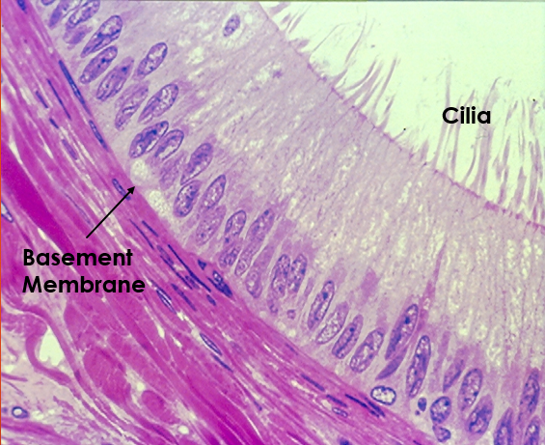
SLIDE “N”
ANSWERS:
Tissue Type?
EPITHELIUM (pseuDostratified and ciliated)
FEATURES/STRUCTURES:
One-layer but appears to be more (Each cell is connected to basement membrane)
Cilia: hair-like structures

Slide 28
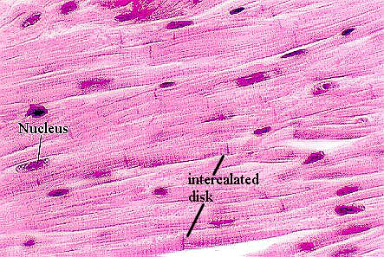
SLIDE “O”
Tissue Type:
FEATURES/STRUCTURES:
Intercalated discs and striations

Slide 29
SLIDE “O” Answers
Tissue Type:
MUSCLE (CardiaC)
FEATURES/STRUCTURES:
Intercalated discs

Slide 30
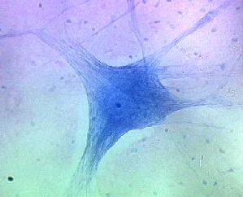
SLIDE “P”
Tissue Type:
FEATURES/STRUCTURES:
Large Structure?
Dark purple spots around large structure?

Slide 31
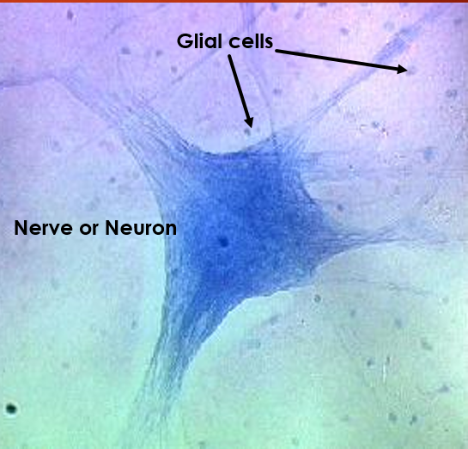
SLIDE “P”
ANSWERS
Tissue Type:
Nervous (Neuron)
FEATURES/STRUCTURES:
Large Structure? Nerve cell
Dark purple spots around large structure? Glial cells that nurture the nerve

