Slide 1
ACT 2015-89
VIRTUAL SCHOOL/PROGRAM OPTION

Slide 2
REQUIREMENTS OF ACT 2015-89
Before the 2016-17 school year, each local board of education shall adopt a policy providing at a minimum, a virtual education option for eligible students in Grades 9 - 12, inclusive, beginning with that school year.

Slide 3
Do all LEAs have to start a virtual school? No
Before the 2016-17 school year, each local board of education shall adopt a policy providing at a minimum, a virtual education option for eligible students in Grades 9 - 12.

Slide 4
Policy
Do all LEAs have to have a policy addressing a virtual program option? Yes, to allow a virtual education option for eligible students in Grades 9 - 12. The policy must be in place before the 2016-17 school year.

Slide 5
Law - Policy shall govern the virtual school program
  Scope and delivery of virtual options
  Student eligibility criteria for initial and continuing participation
  Specific requirements for monitoring performance and testing protocol
  Attendance requirements, if any

Slide 6
LAW – Local School System Enrollment
Students enrolled in the full time virtual program must participate in state testing
Students enrolled in the full time virtual program must participate in accountability requirements through the local school system
Students enrolled in the full time virtual program receive a diploma from the local school system

Slide 7
LAW – Local Schools Enrollment
Full time students enrolled in the virtual program shall be counted in the ADM of the local school
Full time students enrolled in a virtual program in their attendance zone can participate in extracurricular activities of the local school

Slide 8
Options
Within an LEA
  ACCESS delivery
  LEA delivery to their own students
  Vendor purchased
Services purchased from another LEA
Student transfers to another LEA

Slide 9
Within an LEA – Virtual Programs
Who is responsible for virtual student tracking and reporting to the State Department of Education? Reporting will be the responsibility of the home originating school of record in accordance to the LEA policies.
Who is accountable for the virtual student? The home originating school of record.

Slide 10
Within an LEA – Virtual Programs
In virtual programs that serve students from multiple schools where is the student enrolled? The students will be enrolled in their home originating school of record.
In virtual programs that serve students from multiple schools where is the ADM counted? The ADM is counted at the home originating school of record.
The support can be provided at a central location.
Virtual Program can have a separate name such as XYT Academy, but the students are still enrolled in their original schools where the funding and accountability stay.

Slide 11
Virtual Schools
Will virtual schools receive funding using the same formulas as other schools? Yes.
When does a virtual program become a virtual school? Once 250 full time students are enrolled, then an LEA can apply for a separate school code for the new school.
Will the Virtual School receive an A-F Report Card? Yes.

Slide 12
Vendor Purchase of Service
Can an LEA purchase delivery of online courses from a vendor? Yes.
All legal liabilities and monitoring responsibilities are the responsibility of the LEA. Examples:
  Quality: Responsibility of LEA
  Content following Alabama Courses of Study: Responsibility of LEA
  Success of Students: Responsibility of LEA
  Approval by NCAA: Responsibility of LEA
  Special Education Services: Responsibility of LEA
  Teacher Certification and Finger Printing and Background Checks: Responsibility of LEA
Note: Only employees of the LEA should be allowed in iNOW and SETS.

Slide 13
Between LEAs (Purchase of Services)
Can an LEA purchase course delivery from another LEA? Yes, through contracts just like purchase from a vendor.
If the LEA purchases course delivery from another LEA will it affect the ADM of the home originating LEA? No, the source of the delivery of the course or courses does not affect funding, ADM, and attendance. Virtual course(s) delivery can be purchased from another LEA just like purchase from a vendor.

Slide 14
Counseling
Responsibility of LEA in all Models.
What about counseling of full time online students? Very Important!
It is strongly recommended, and cautioned, that schools provide each student with counseling related to their career path planning with all virtual learning options. A full time virtual program is not for every student.
School personnel should be aware and advise students as to courses not accepted by a student’s chosen institution of higher education.
Caution should also be given to Alabama High School Athletic Association/NCAA rules imposed on traditional public school students when determining career path/courses in order to assure retention of eligibility. NOTE: NCAA requires all online courses to be approved and identified on the student’s transcript.

Slide 15
LAW - DELIVERY OF INSTRUCTION
For courses an LEA purchases from a vendor or another LEA or delivers using their own teachers:
  Exempt from any provision of law
  Not subject to online course restrictions by the SDE
  LEA responsibility that they are accredited by an institution recognized pursuant to administrative rule adopted by the department
  LEA responsibility that all courses contain the required Alabama Course of Study content

Slide 16
Local Boards of Education are exempt from any provision of general law, local law, or administrative rule that applies to traditional delivery of instruction:
Physical presence
Student monitoring
Security
Staffing requirements
Space and location requirements
Time requirements
Physical Education requirements

Slide 17
Accreditation
How will accreditation change? Accreditation of courses should be considered as well as accreditation of schools and/or LEA.
All college preparatory ACCESS courses are approved by NCAA except Credit Recovery/Credit Advancement. It is the LEA’s responsibility to obtain accreditation for online courses delivered that are not delivered by ACCESS.
NCAA requires all online courses to be approved and identified on the student’s transcript.

Slide 18
Teacher of Record
Are all virtual students required to have a teacher of record to assign grades? Yes.
Who is the teacher of record that assigns the grade? Local decision.
Only LEA employees should have access to iNOW and SETS.
How will HQT be reported? As it is currently.

Slide 19
Certification
Is the online educator required to be certified? Yes. The online educator must hold valid professional educator certification in Alabama or in another state. The ALSDE strongly recommends that all online educators hold valid Alabama certification.
Why Alabama certification? If a teacher is Alabama certified then the educator has successfully completed a criminal history background check through the ALSDE.

Slide 20
Criminal History Background Check
LEAs must include in their contracts with vendors that online educators/employees with unsupervised access to students (virtually or in-person) are required to complete a criminal history background check through the ALSDE pursuant to the Alabama Child Protection Act.
Online educators/employees who do not hold valid Alabama certification will be considered contract employees subject to the provisions of the Alabama Child Protection Act. With this designation, these employees will need to complete a criminal history background check through the ALSDE as a “classified” employee.

Slide 21
Criminal History Background Check
After criminal history background results are submitted by the Alabama State Bureau of Investigation (ASBI) and the Federal Bureau of Investigation (FBI) to the ALSDE, one of the following types of correspondence will be sent from the ALSDE to both the online educator/employee and the LEA superintendent of record:
  A letter confirming the absence of any criminal convictions and/or pending charges as reported by ASBI and FBI.
  A letter confirming any known criminal convictions or pending charges as reported by ASBI and FBI.
  A closing letter confirming that an ASBI/FBI criminal history background check could not be completed due to the applicant’s failure to provide required documents to the ALSDE. This individual is prohibited from working until he or she has complied with all requests from the ALSDE for information and a full review of the individual’s criminal history has been completed by the ALSDE.

Slide 22
Criminal History Background Check
Upon the completion of the review, in all cases mentioned above, a corresponding message will be posted to the ALSDE’s Certification Portal, which is on the ALSDE web site and available to both authorized users and members of the public.
Online educators/employees who do not hold valid Alabama certification and provide services for multiple LEAs must provide to the superintendent of each LEA a copy of their final letter from the ALSDE. LEA superintendents who receive a copy of the final letter from the online educator/employee are strongly advised to verify its content by contacting the Educator Certification Section of the Office of Teaching and Leading.

Slide 23
Criminal History Background Check
Please be aware that it is the affirmative responsibility of the LEA to determine the online educator’s/employee’s eligibility for employment.

Slide 24
Who is going to monitor this law? The SDE will monitor the sections that apply to Federal law such as Title I and Special Education.
What must the LEA do in terms of special needs students? The LEA must provide the services outlined in the IEP.

Slide 25
School Codes
A virtual school is coded as a virtual program until 250 full time virtual students have enrolled.
Virtual Program – A virtual program provides online courses to students who are enrolled in a home originating school of record.
  As a virtual program, accountability will reside with the home originating school of record.
  The home originating school of record issues the credits and awards the diplomas. All data will be reported to the SDE through the home originating school of record.
  As a virtual program, ADM funding will reside with the home originating school of record. Instructional support and teacher units are earned by the home originating school of record. A virtual program will provide the administrator and other staff necessary to operate the virtual program.
  The LEA may have all of their full time virtual students report to one virtual program site for testing and facilitation without meeting the requirement of 250 full time virtual students for a school. The LEA may allow students at home to come to the virtual program site only for testing and mentoring help or attend at the virtual program site as needed.
  The LEA must determine testing site(s) and designate in their virtual policy and LEA test security plan. The SDE must approve the LEA assessment and test security plan.

Slide 26
Course Content
Are schools required to use ACCESS for the curriculum? No.
Coursework/Course content must meet the standards as identified in the applicable Alabama courses of study.

Slide 27


ACCESS and
Alabama’s Virtual Schools
Larry Raines
Office of Educational Technology

Slide 28
Law - SDE
SDE - shall provide a repository of quality content and curriculum for local boards
SDE - continue to provide ACCESS
  Can an LEA (school) use ACCESS to meet the requirements of a virtual option according to Act 2015-89? Yes.
  Is an LEA (school) required to have other options in addition to ACCESS for the virtual option according to Act 2015-89? No.

Slide 29
ACCESS
Began offering courses in January 2006
Completed 10 years of providing quality online courses aligned to current Alabama COS using Alabama teachers
Recognized as the 3rd largest program in the United States
Provided over 116 courses in 2014-2015 to Alabama students including AP, CR, and CA (and continues to do so)

Slide 30
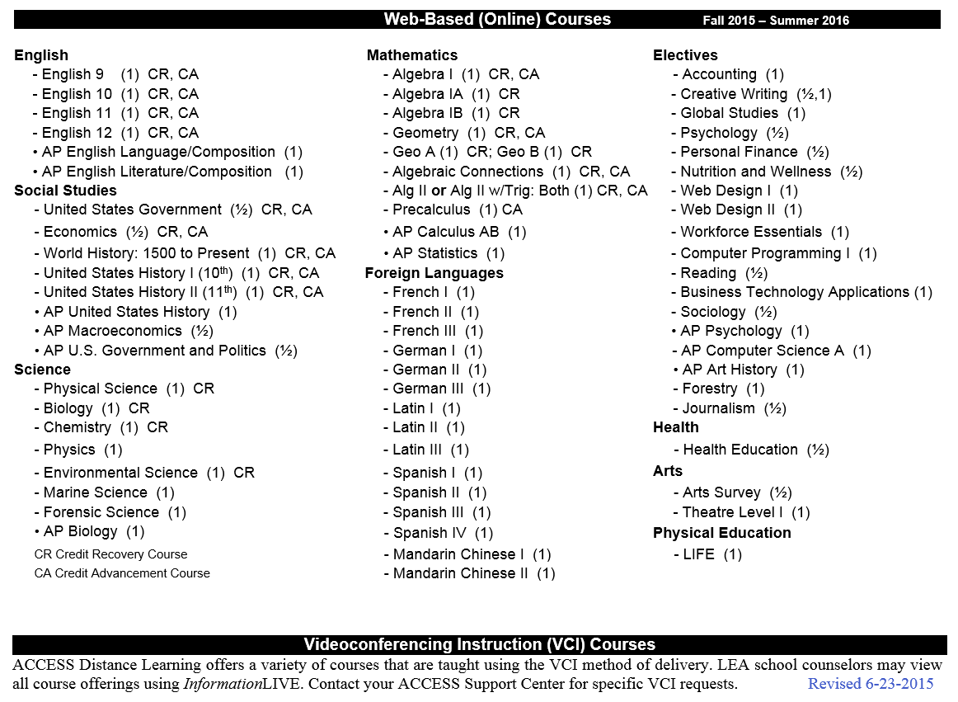

Slide 31
Why use ACCESS to meet your requirement for a Virtual Option?
Alabama Teacher Certification
Quality Content – aligned/reviewed by Alabama HQ teachers, follow Alabama Courses of Study, and NCAA Approved (except Credit Recovery/Advancement)
Free to LEAs and Schools – funded as a line item in the ETF budget

Slide 32
ACCESS – Teacher Certification
When using ACCESS, is the facilitator required to be certified? No, when using ACCESS, the ACCESS Support Centers have taken the responsibility of ensuring that all online teachers are Alabama Certified in the subject area, and are finger-printed and background checked. The facilitator is not required to be certified.
When using ACCESS, is the facilitator required to be finger-printed and background checked? Yes, as an employee of the LEA.

Slide 33
NCAA Approval
Courses taught by Regular ACCESS approach/ACCESS Teachers
Non-traditional
Fifty courses
NCAA Website listings (Do not include on the school’s course list)
Directions found on ACCESS Website: http://accessdl.state.al.us/
Credit Recovery/Advancement courses NOT accepted
Franchise Model – Courses fall under local schools’ lists and not ACCESS.

Slide 34
Section 3 of the ACT states that the State Department of Education shall provide a repository of quality content and curriculum for local boards of education providing virtual education.
Currently Provided:
The Alabama Connecting Classrooms, Educators, and Students Statewide (ACCESS) Program
The Franchise Model

Slide 35
The ACCESS Franchise Model
Content from ACCESS courses
Alabama COS standards covered – aligned/reviewed by Alabama HQ teachers
Moodle used as the LMS
Courses are taught by local teachers
Pilot - Fall of 2011, 2012
System Pilot – Fall of 2013
Open to all – Fall of 2014
Blount County, Boaz City, Chilton County, Dothan City, Florence City, Hoover City, Huntsville City, Lauderdale County, Lawrence County, Montgomery County, Muscle Shoals City, Roanoke City, Sheffield City, Talladega County

Slide 36
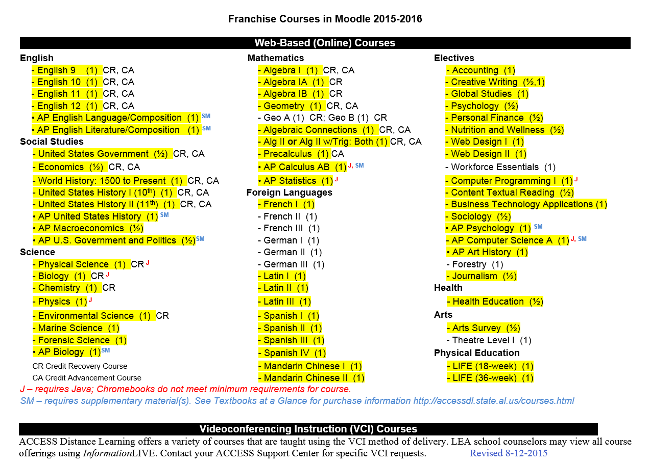

Slide 37
Larry Raines
lraines@alsde.edu
(334)242-9594

Slide 38
SUPPORT
  The most critical aspect to plan!
  Talk to ACCESS staff at the SDE
  Talk to ACCESS Support Center
  Talk to Mobile or Baldwin County and others

Slide 39
Questions
Please type your questions in the Chat Box.
Melinda Maddox, Ed.D.
Deputy State Superintendent of Education
Office of Technology and Data
mmaddox@alsde.edu
334-242-9716

